Slide 1
Solving linear systems: from
Ax = b to the best-fitting line
How does a computer find the best straight line through data in one step, and why does a model with more features than rows break?
Mathematics for AI and Machine Learning | Session 4 of 18 | Linear algebra
KLAi Professional Learning | Jotham Martin Wambi
Notes:
Welcome to Session 4. Last time we used matrices to move and mix numbers. Today we run that machinery backwards: given the result, find the input. That is solving a linear system, and fitting a line to data turns out to be the same job. By the end you will fit a line with one equation, in Python and in a spreadsheet.

Slide 2



Today in one view: what you will leave with
By the end of today you can
Write a system of equations as Ax = b and solve it by elimination and with the inverse
Say what the determinant and the rank tell you, and when a system has no solution or many
Fit a line by least squares with the normal equation, in Python and in a spreadsheet
Notes:
By the end of today you can write a system of equations in matrix form, as A x equals b, and solve it by elimination and with the inverse. You can say what the determinant and the rank tell you, and why some systems have no solution or many.
And you can fit a line to data using the normal equation, in Python and in a spreadsheet, with the same numbers in both. Which of these would you like to be able to explain to a colleague?

Slide 3
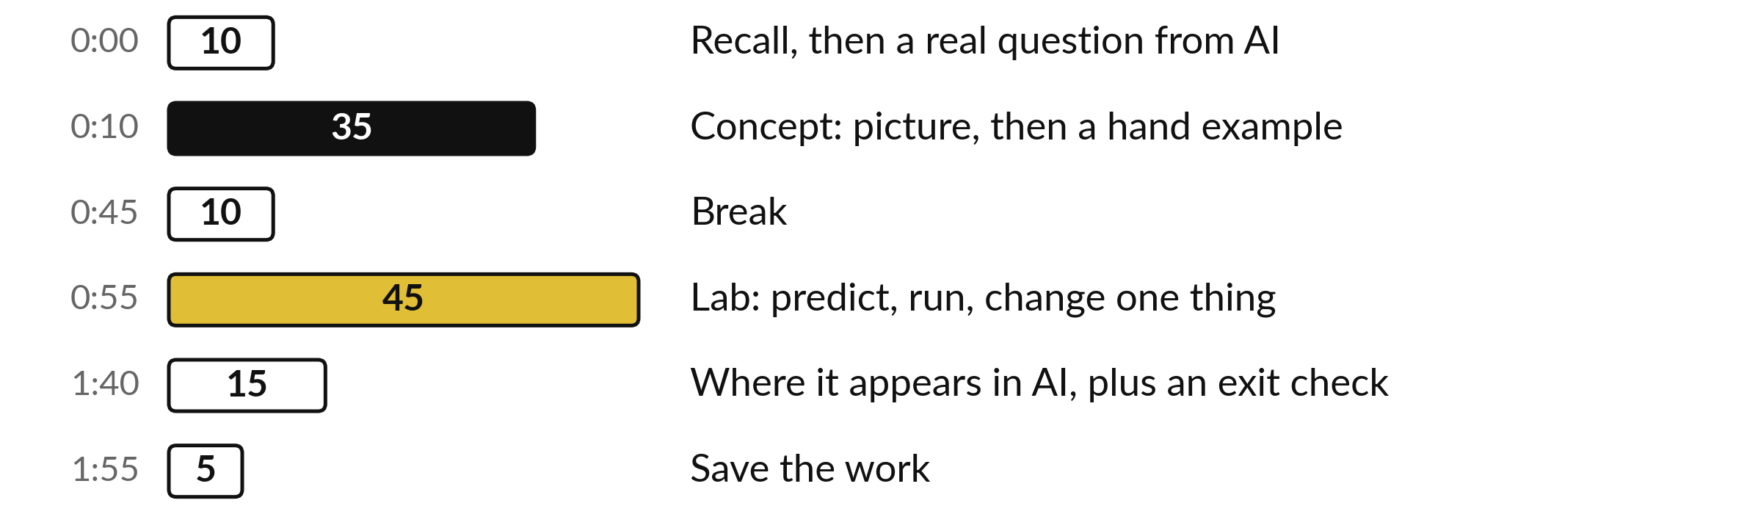
Your two hours: equations, then a fitted line
Ideas first, with pictures. Then the lab in Python or in a spreadsheet. Then where it shows up in AI.
Notes:
We have two hours. The first ten minutes bring back Session 3 on matrices and set our question for the day. Then thirty-five minutes of ideas, each as a picture and then a small calculation by hand. After a ten minute break comes the lab, forty-five minutes, in Python or in a spreadsheet, on the same numbers.
We finish with where this appears in AI tools, an exit check and five minutes to save your work.

Slide 4

Three questions from last time
1. A is a 3 by 2 matrix and B is a 2 by 4 matrix. Can you multiply A times B, and what is the shape of the result?
2. What does the matrix with rows (2, 0) and (0, 3) do to the vector (1, 1)?
3. What does the identity matrix I do to any vector x?
Answer aloud first. Then we check together.
Notes:
Three quick questions from Session 3. Answer aloud first, and then we check together. It is a warm-up to bring last time back.
Question one. A is a 3 by 2 matrix and B is a 2 by 4 matrix. Can you multiply A times B, and what is the shape of the result? Take a moment.
A good answer is this. Yes. The inner numbers match (2 and 2). The result is 3 by 4.
Question two. What does the matrix with rows (2, 0) and (0, 3) do to the vector (1, 1)? Say it to yourself first.
A good answer is this. It gives (2, 3). It stretches the first direction by 2 and the second by 3.
Question three. What does the identity matrix I do to any vector x? Think about your own task as you answer.
A good answer is this. Nothing. I times x equals x. It is the matrix version of the number 1.
If an answer was missing, do not worry. Your notes from last class have it. Now to today.

Slide 5
Answers to the three questions from Session 3
Question | Short answer
A is a 3 by 2 matrix and B is a 2 by 4 matrix. Can you multiply A times B, and what is the shape of the result? | Yes. The inner numbers match (2 and 2). The result is 3 by 4.
What does the matrix with rows (2, 0) and (0, 3) do to the vector (1, 1)? | It gives (2, 3). It stretches the first direction by 2 and the second by 3.
What does the identity matrix I do to any vector x? | Nothing. I times x equals x. It is the matrix version of the number 1.
If one surprised you, look back at Session 3 before the lab. The identity matrix returns today as part of the inverse.
Notes:
Here are the short answers. First, a three by two times a two by four works, because the inner numbers match, and the result is three by four. Second, the matrix with rows two zero and zero three gives two and three, so it stretches the first direction by two and the second by three.
Third, the identity matrix does nothing: I times x equals x. That last one matters today, because the inverse is defined using it. If one of these surprised you, look at Session 3 again before the lab.

Slide 6



Words we use today
Word | What it means
Linear system | Several equations in the same unknowns, written together as Ax = b.
Inverse | The matrix A⁻¹ that undoes A: A⁻¹ times A is the identity matrix.
Determinant | One number from a square matrix. Its size is the factor by which A scales areas.
Rank | How many independent directions the columns of a matrix give: no chosen column can be built from the others.
Least squares | Choosing the line whose squared errors add up to the smallest total.
Notes:
Five words for today. I give the plain meaning of each, and we use every one of them before the end of the session.
Linear system. Several equations in the same unknowns, written together as Ax = b.
Inverse. The matrix A⁻¹ that undoes A: A⁻¹ times A is the identity matrix.
Determinant. One number from a square matrix. Its size is the factor by which A scales areas.
Rank. How many independent directions the columns of a matrix give: no chosen column can be built from the others.
Least squares. Choosing the line whose squared errors add up to the smallest total.

Slide 7
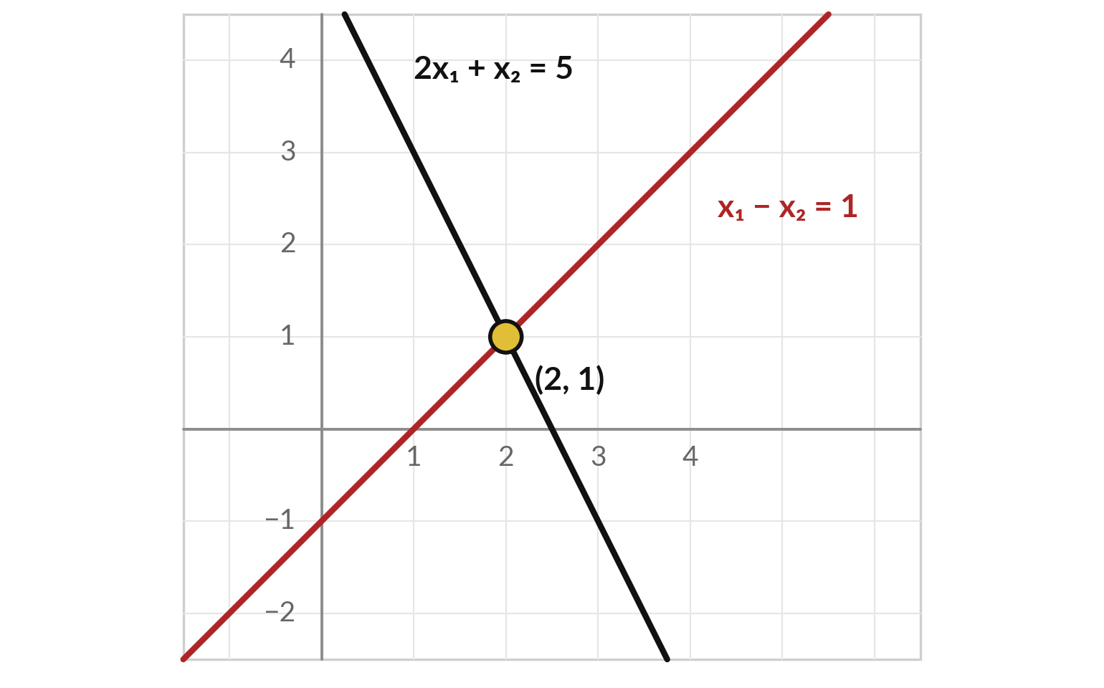
A system of equations is a set of lines,
and the solution is where they cross
Two equations, two unknowns, x₁ (across) and x₂ (up). Each equation draws one line.
The gold dot lies on both lines, so it satisfies both equations.
It is the pair x₁ = 2, x₂ = 1.
Check: 2 × 2 + 1 = 5 and 2 − 1 = 1.
Notes:
Start with a puzzle you could do in school. Two equations, two unknowns, which we call x one and x two. Two x one plus x two equals five, and x one minus x two equals one. Each equation is a straight line when you draw it. A point on the first line satisfies the first equation.
A point on the second line satisfies the second. The one point on both lines, the gold dot, satisfies both, and that is the solution: x one equals two, x two equals one. Check it in the first equation: two times two plus one is five. Now, how would a computer find that dot without drawing anything?

Slide 8

The same system in matrix form is Ax = b
Symbol | What it means | In our data
A | The matrix of coefficients. Row 1 is (2, 1) and row 2 is (1, −1). | 2 by 2 matrix
x | The vector of unknowns, the numbers we want. Its entries are x₁ and x₂. | (x₁, x₂)
b | The vector of right-hand sides. | (5, 1)
Ax | Matrix times vector from Session 3: each row of A takes a dot product with x. | (2x₁ + x₂, x₁ − x₂)
Ax = b says: apply A to the unknown x and you get b. Solving means running A backwards.
Notes:
Now we write the same system the way machine learning libraries want it. Put the coefficients in a matrix A, the unknowns in a vector x, and the right-hand sides in a vector b. The product A times x, from Session 3, takes each row of A and forms a dot product with x.
That gives two x one plus x two in the first slot and x one minus x two in the second. Setting that equal to b gives exactly our two equations. So A x equals b says: apply A to the unknown and you land on b. Solving the system means running A backwards.

Slide 9
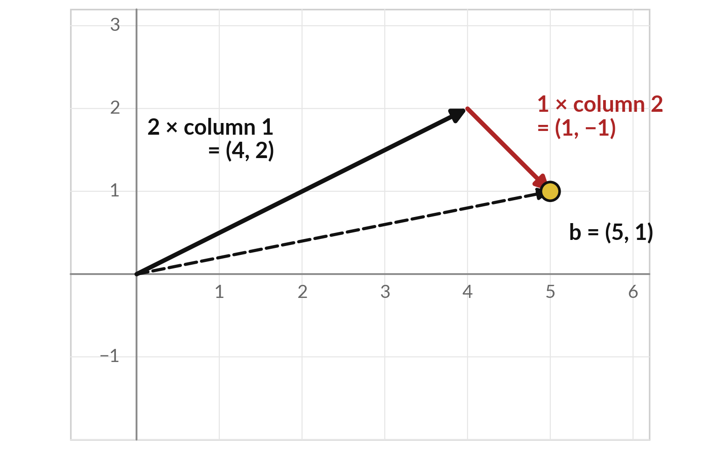
The column picture: b is a mix of the columns of A
The columns of A are the arrows (2, 1) and (1, −1). How much of each adds up to b?
2 of column 1 reaches (4, 2). Then 1 of column 2 moves on to (5, 1).
That is b. So the solution (x₁, x₂) = (2, 1) lists how much of each column to use.
Notes:
There is a second way to see the same system, and it is the one machine learning uses most. Read the columns of A as arrows. Column one is the arrow two, one. Column two is the arrow one, minus one. The question becomes: how much of each arrow do I add to reach b?
Two lots of column one take me to four, two. One lot of column two then takes me to five, one, which is b. So the solution, x one equals two and x two equals one, is simply the recipe: two of the first column and one of the second.
Which picture do you find easier, the lines or the arrows?

Slide 10
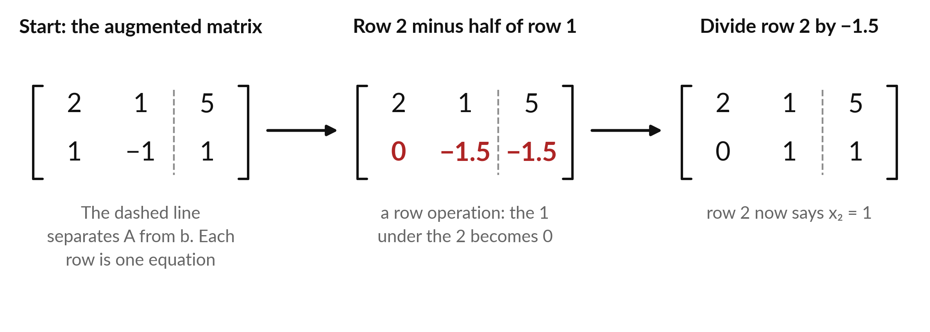
Elimination solves the system by making zeros,
then reading the answer from the bottom
Row operations make zeros, then back substitution reads upwards. Together: Gaussian elimination.
Notes:
Elimination is what you do by hand, and it is how computers solve systems too. We write the coefficients and the right-hand sides together, with a dashed line between them. That layout is called an augmented matrix. Then we subtract half of row one from row two. That is a row operation, and it makes the one under the two become zero.
Row two now says minus one point five x two equals minus one point five. Divide, and x two equals one. Then go back up: row one says two x one plus one equals five, so x one equals two. Making zeros and reading upwards is called Gaussian elimination, with back substitution for the last part.
Try the same steps yourself on a different pair of equations later.

Slide 11
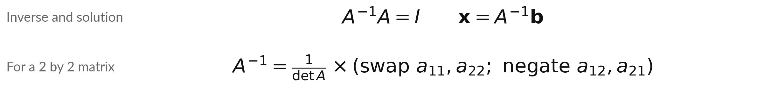
The inverse undoes A, so x = A⁻¹b
Symbol | What it means | In our data
A⁻¹ | The inverse of A: the matrix that undoes A. | exists only if det A is not 0
I | The identity matrix, which leaves every vector unchanged. | rows (1, 0) and (0, 1)
a₁₁ to a₂₂ | The entries of A: row 1 is (a₁₁, a₁₂) and row 2 is (a₂₁, a₂₂). | 2, 1, 1, −1
det A | The determinant of A: a₁₁a₂₂ − a₁₂a₂₁. | 2 × (−1) − 1 × 1 = −3
If x = A⁻¹b, then Ax = AA⁻¹b = Ib = b. The answer undoes the system.
Notes:
Multiplying by A turns x into b. So there should be a matrix that turns b back into x. That matrix is the inverse, written A to the minus one. It is defined by one rule: A inverse times A gives the identity matrix. Then x equals A inverse times b.
For a two by two matrix the inverse has a simple recipe. Swap the two diagonal entries, put a minus sign on the other two, and divide everything by the determinant, a one one times a two two, minus a one two times a two one. That number will be the star of the next few slides.
Notice the inverse fails if it is zero, because you cannot divide by zero.

Slide 12
Worked example: the inverse of
our A, and the solution from it
A has rows (2, 1) and (1, −1). We find the inverse, then multiply it by b = (5, 1).
Determinant
det A = 2 × (−1) − 1 × 1 = −3. It is not 0, so the inverse exists.
Inverse
Swap and negate: rows (−1, −1) and (−1, 2). Divide by −3: rows (1/3, 1/3) and (1/3, −2/3).
Solution
x = A⁻¹b: first entry (5 + 1) / 3 = 2. Second entry (5 − 2) / 3 = 1.
Check
A times (2, 1) gives (2 × 2 + 1, 2 − 1) = (5, 1). It equals b.
Notes:
Let us run the recipe on our matrix. The determinant is two times minus one, minus one times one, which is minus three. It is not zero, so the inverse exists. Swap the diagonal entries and negate the other two, giving rows minus one, minus one and minus one, two.
Divide by minus three. Now multiply by b, which is five, one. The first entry is five plus one, over three, which is two. The second is five minus two, over three, which is one. We got back x one equals two, x two equals one. Always finish with a check, as in the last block.

Slide 13
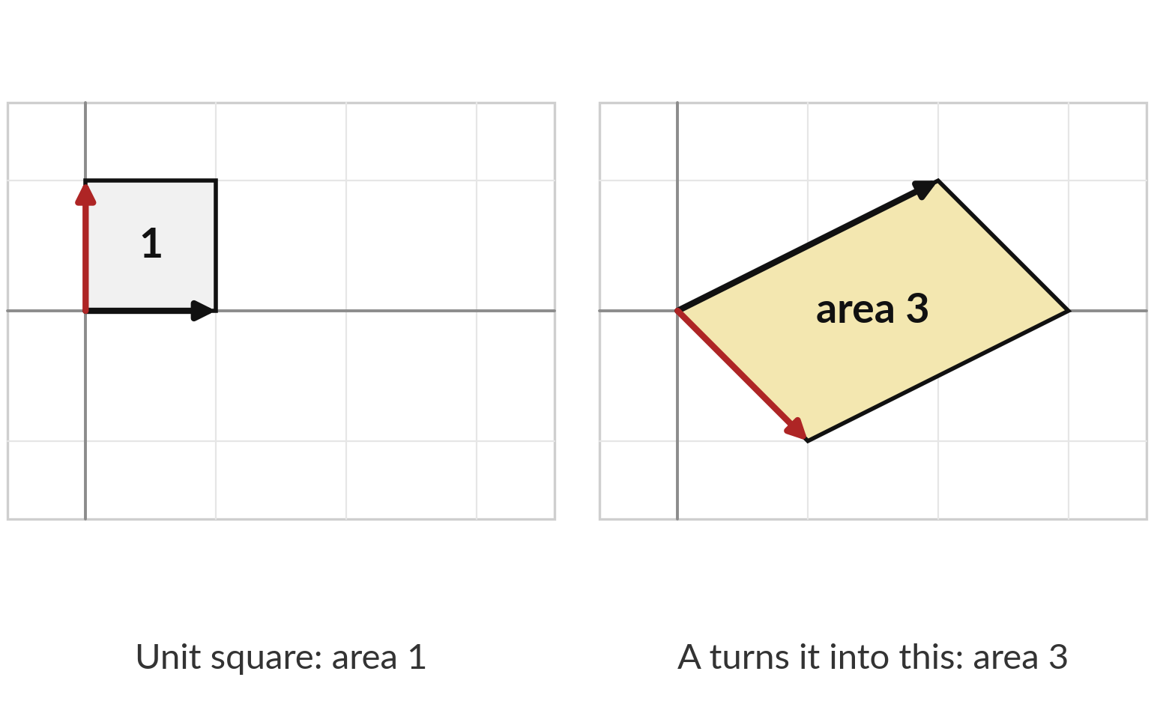
The determinant is the factor
by which A scales areas
The two red and black arrows are the columns of A. A sends the unit square onto the gold parallelogram.
Its area is 3, so A scales areas by 3.
det A = −3. The size is the area factor.
The minus sign means the picture is also flipped, like a mirror.
Notes:
Here is the picture behind that number. Take the unit square, area one, with sides along the two basic directions. Apply A. The sides become the columns of A, and the square becomes this gold parallelogram. Its area is three. So A multiplies every area by three, and the determinant is minus three.
The size three is the area factor. The minus sign tells us orientation flipped, like looking in a mirror. This picture explains why a determinant of zero is special. What would an area of zero look like?

Slide 14
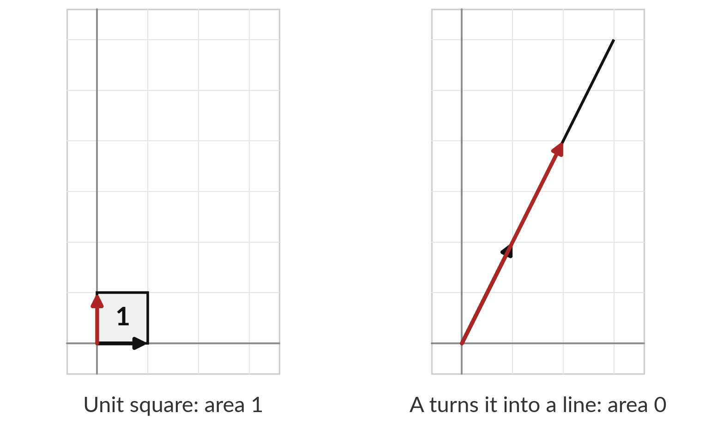
When the determinant is 0, A squashes
the plane flat and has no inverse
This matrix has columns (1, 2) and (2, 4). Both arrows point the same way.
The square collapses onto one line, so the area is 0.
det = 1 × 4 − 2 × 2 = 0.
Many inputs land on the same output, so nothing can undo it: no inverse. Such a matrix is called singular.
Notes:
Now change the matrix so that its columns are one, two and two, four. The second column is just twice the first. Both arrows point the same way, so the unit square gets squashed onto a single line. The area is zero, and the determinant is one times four minus two times two, which is zero.
Once many different inputs land on the same output, no matrix can send them back, because it would not know which input to return. So there is no inverse. We call such a matrix singular. What do you think this means for the equations A x equals b?

Slide 15
Rank counts how many independent
directions the columns give
Matrix | Determinant | Rank | What the columns can reach
Our A: columns (2, 1) and (1, −1) | −3 | 2 | The whole plane
Singular: columns (1, 2) and (2, 4) | 0 | 1 | Only one line
Zero matrix: all entries 0 | 0 | 0 | Only the origin
Rank = the largest number of columns you can choose so that none of them can be built from the others. A 2 by 2 matrix has an inverse exactly when its rank is 2.
Notes:
Rank is the next word. It is the largest number of columns you can choose so that none of the chosen columns can be built from the others. Our matrix has rank two, because its two arrows point in different directions and together they can reach the whole plane.
The singular matrix has rank one, because the second column is a copy of the first, stretched, so everything lands on one line. The zero matrix has rank zero. For a two by two matrix, rank two means a nonzero determinant and an inverse. Rank less than two means determinant zero and no inverse.

Slide 16
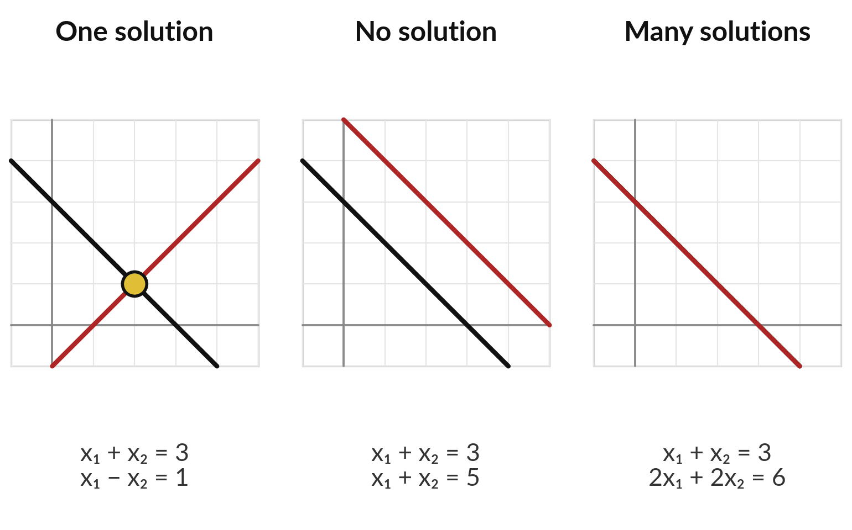
A system has one solution, none, or
many, and rank and b decide which
Lines that cross once give one solution. Parallel lines never meet. The same line twice meets everywhere.
Full rank: exactly one solution.
Rank below full: no solution or infinitely many, depending on b.
Notes:
Putting it together, there are three possible outcomes for a linear system. If the lines cross once, there is exactly one solution, and the matrix has full rank. If the lines are parallel, they never meet and there is no solution. If the second equation is just the first one doubled, the two lines sit on top of each other, and every point on the line is a solution, so there are infinitely many.
In the last two cases the matrix has rank one, below full. Which of the three pictures would a data table with exactly the right number of independent rows give?

Slide 17
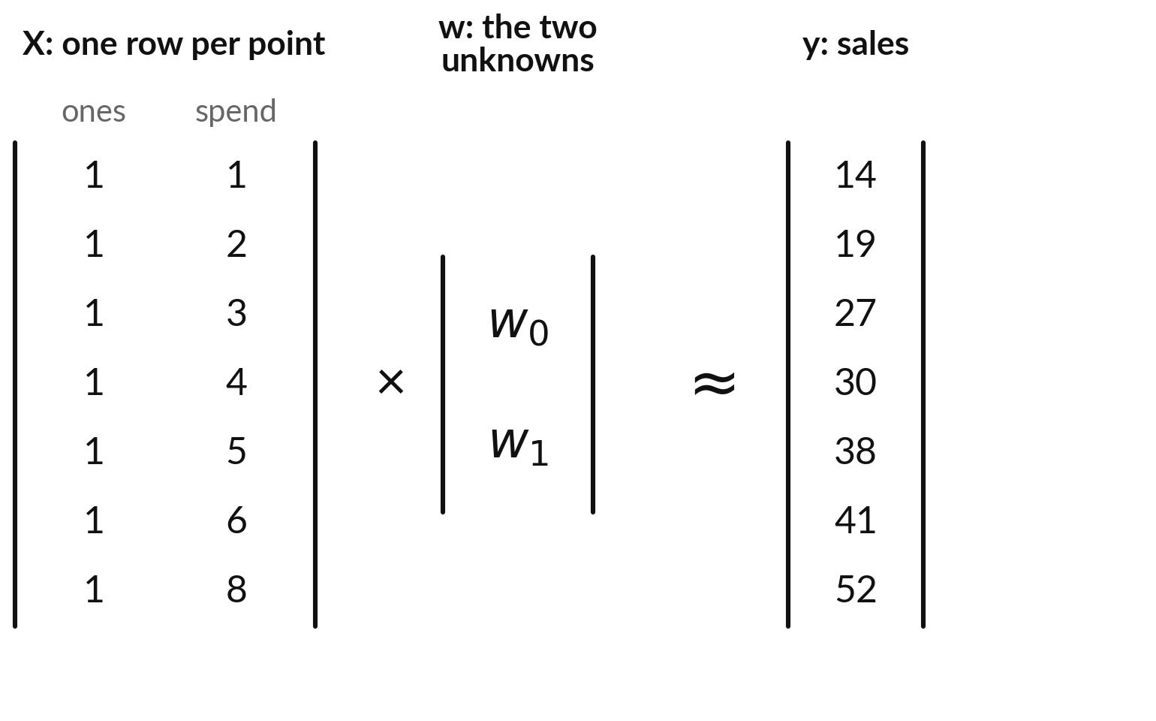
Fitting a line to 7 data points is 7
equations with only 2 unknowns
Each row says w₀ + w₁ × spend = sales, for one month. Seven rows, two unknowns.
X has a column of ones, so w₀ is the intercept (the bias), and a column of spend values.
w holds w₀ and the slope w₁ (the weight).
The points do not sit on one line, so no exact solution exists.
Notes:
Now the real problem from machine learning. We have seven months of data: advertising spend and sales, both in millions of Uganda shillings, invented to illustrate the arithmetic. We want a line, sales equals w zero plus w one times spend. Here w zero is the intercept, which Session 1 called the bias, and w one is the slope, which Session 1 called the weight.
Every month gives one equation. Put the equations in matrix form: X has a column of ones, so w zero is the intercept, and a column of spend values. That is seven equations and two unknowns, a tall system. The points do not lie on one line, so no w satisfies all seven exactly.
What should we do instead?

Slide 18
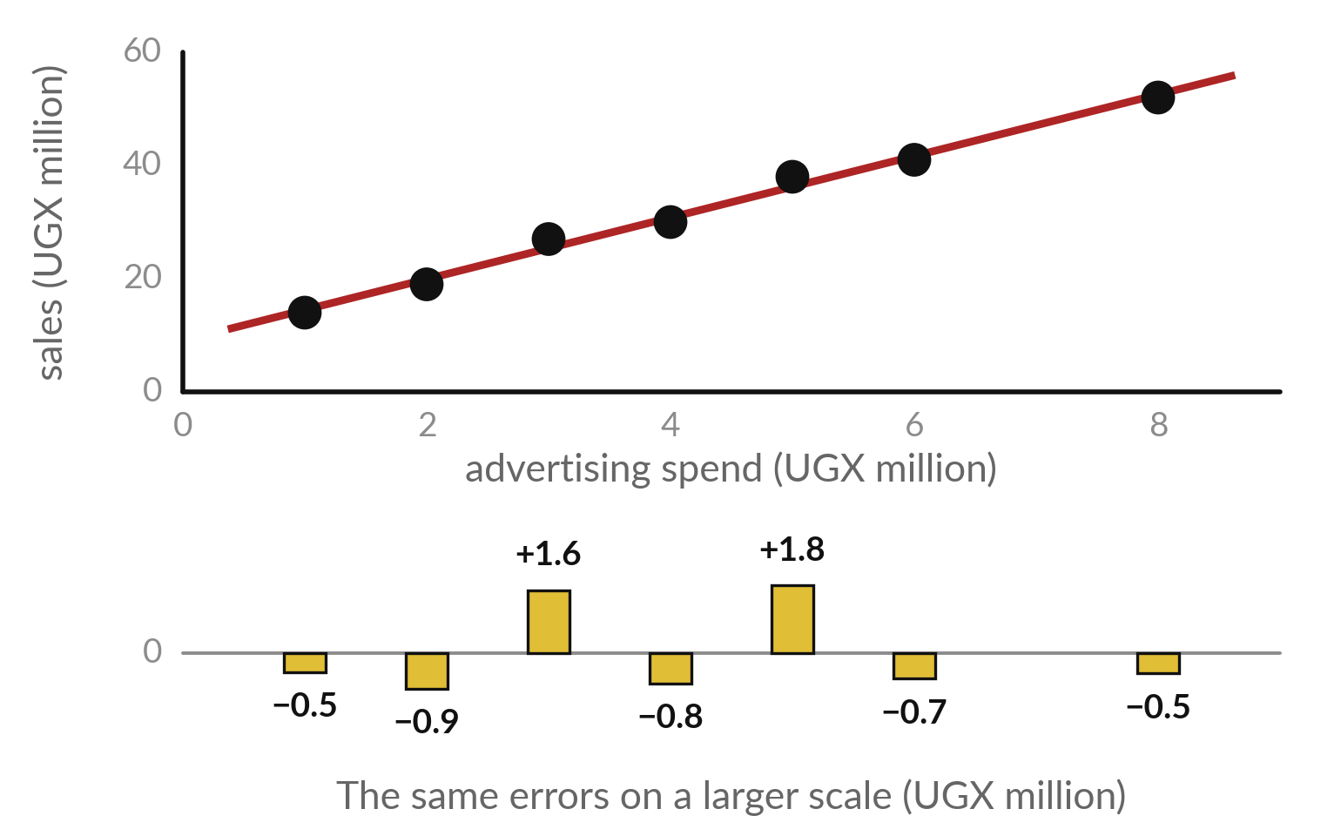
Least squares picks the line with
the smallest sum of squared errors
Each dot is one month. The gold bars show its error, also called the residual: actual sales minus the line's prediction.
Line: sales = 9.06 + 5.43 × spend.
Least squares makes the sum of squared errors smallest: 8.28.
RMSE (root mean squared error) = √(8.28 ÷ 7) = 1.09.
Notes:
If no line is perfect, choose the best one. For each month, the error is the actual sales minus the value the line predicts. It is also called the residual. The gold bars below the picture show them on a larger scale, with their signed size. Square each error, so that plus and minus cannot cancel, and big misses count more.
Add them up. Least squares chooses the intercept and slope that make this total as small as possible. For our illustrative data the answer is the line sales equals 9.06 plus 5.43 times spend, with a total squared error of 8.28. Divide by seven, take the square root, and you get the root mean squared error, RMSE, of 1.09 million.
We use it as the size of a typical miss. How long does the computer take to find this line?

Slide 19
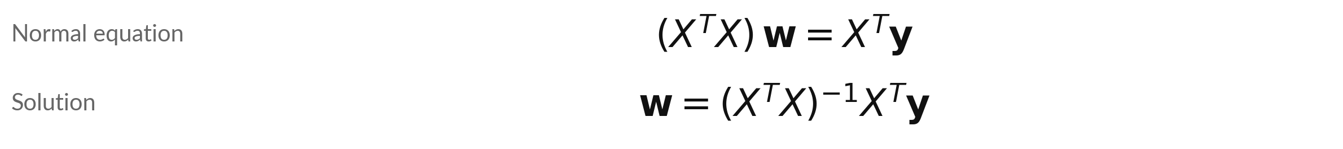
The normal equation turns the tall
system into a small square one
Symbol | What it means | In our data
X | The data matrix, a column of ones then the features. Tall: more rows (equations) than columns (unknowns). | 7 rows (months), 2 columns
Xᵀ | The transpose: rows and columns swapped. | 2 rows, 7 columns
y | The target vector, the numbers to predict. | sales, 7 numbers
w | The weights to find: intercept first, then slopes. | w₀ and w₁
XᵀX | A square matrix with one row per unknown. | 2 by 2
Multiplying by Xᵀ makes the errors meet every column of X at right angles, which is when the squared errors are smallest.
Notes:
Here is the key formula of the session. A tall system has more rows, which are equations, than columns, which are unknowns. Multiply both sides of X w equals y by X transpose, and the tall system becomes X transpose X times w equals X transpose y. That step picks the w for which the errors are at right angles to every column of X, which is exactly when the squared errors are smallest.
X transpose X is square, with one row for each unknown, so it is a two by two system that we know how to solve. This is called the normal equation. If X transpose X has an inverse, w equals its inverse times X transpose y. Read the table row by row, and say what each symbol is in our data.

Slide 20
Worked by hand: the normal equation, 7 points
Illustrative data: spend 1, 2, 3, 4, 5, 6, 8 and sales 14, 19, 27, 30, 38, 41, 52 (UGX million).
XᵀX
Rows (7, 29) and (29, 155): the count, the sum of spend, the sum of spend squared.
Xᵀy
Entries (221, 1105): the sum of sales, and the sum of spend times sales.
Solve
Determinant = 7 × 155 − 29 × 29 = 244. w₀ = (155 × 221 − 29 × 1105) / 244 = 9.06. w₁ = (7 × 1105 − 29 × 221) / 244 = 5.43.
Meaning
One more million of spend goes with 5.43 million more sales. At spend 7 it predicts 47.1.
Notes:
Let us do it by hand once. X transpose X works out to rows seven, twenty-nine and twenty-nine, one hundred fifty-five: the count, the sum of spend, and the sum of spend squared. X transpose y is two hundred twenty-one and one thousand one hundred five. The determinant is seven times one fifty-five minus twenty-nine squared, which is two hundred forty-four.
Solving gives w zero equal to 9.06 and w one equal to 5.43. So each extra million of spend goes with about 5.43 million more sales in this made-up data. Be careful with the word goes with. A fitted line shows an association, and it does not by itself prove that spending causes sales.

Slide 21


Two ways to solve: the inverse, or a solver
Inverse
Solvers
x = A⁻¹b is the idea to understand.
Computing the whole inverse takes more work.
For large matrices it is usually less accurate.
solve(A, b) factorises A, a form of elimination.
lstsq(X, y) fits by least squares, using the SVD (Session 6).
Learn the inverse to understand it. Use a solver to compute.
Notes:
You now have two ways to solve on a computer, after elimination by hand. The inverse is the cleanest idea, x equals A inverse times b. But computing a whole inverse takes more work and is usually less accurate for large matrices. A solver is the other way.
You give the computer A and b, and the function solve factorises A, which is a form of elimination. For a least squares fit you can use lstsq directly on X and y. It is based on the singular value decomposition, which we meet in Session 6. In practice people use the solver.
In the lab you will try these and compare. Which would you use for a ten thousand row table?

Slide 22
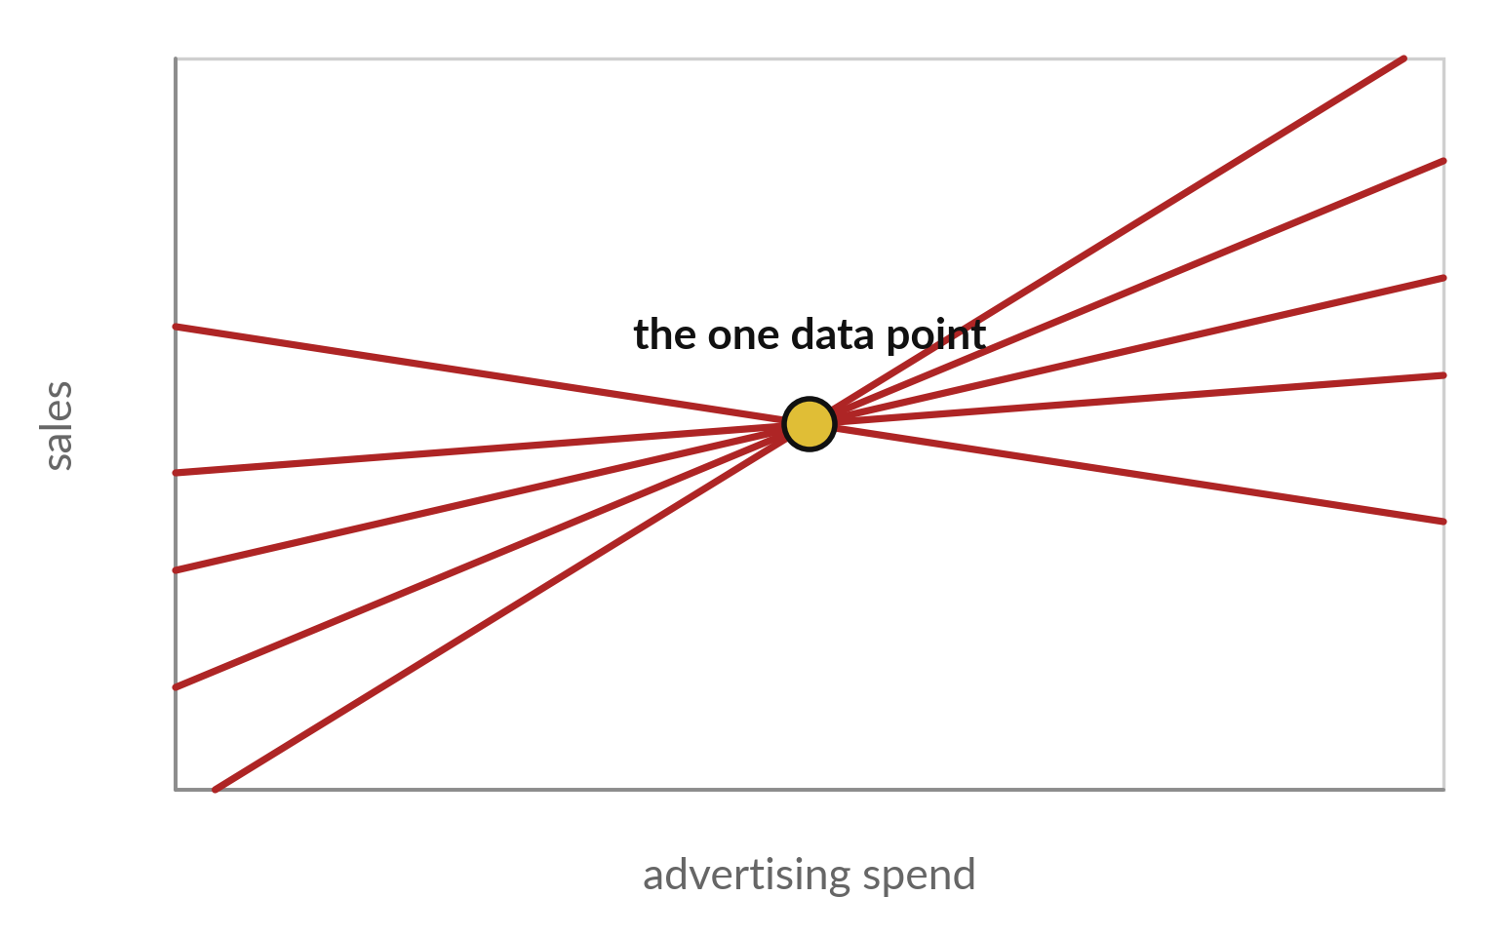
Too many unknowns and too few
rows: infinitely many lines fit perfectly
One data point and two unknowns, the intercept and the slope. Every red line through the point fits it exactly.
With spend 4: XᵀX has rows (1, 4) and (4, 16), and determinant 1 × 16 − 4 × 4 = 0.
The rank of X is at most its number of rows, here 1, so the rank of XᵀX is at most 1. No inverse, so the normal equation has many answers.
Notes:
Now the warning from the real question of the day. Suppose we had a single month of data. One equation, two unknowns. Any line through that point fits perfectly. The data cannot choose between them. The rank of X is at most its number of rows, here one, so X transpose X also has rank at most one.
Its rows are one, four and four, sixteen, and its determinant is sixteen minus sixteen, which is zero. It has no inverse, so the normal equation has many answers. The same happens whenever there are more unknowns than rows. A model with more weights than data points can fit anything, and the fit means nothing. Later sessions show a standard fix, called regularisation.

Slide 23

Common mistake: four ways a solve goes wrong
Mistake | Why it fails | What to do
Dividing by a matrix | There is no matrix division. | Multiply by the inverse, on the left: A⁻¹b.
Inverting when the determinant is 0 | A singular matrix has no inverse. | Check the determinant or the rank first.
Leaving out the column of ones | The line is forced through the origin. | Add a column of 1s to X for the intercept.
Swapping the order of a product | AB and BA usually differ. | Keep A⁻¹ on the left of b.
Notes:
Four mistakes I see again and again. First, dividing by a matrix. There is no such operation. You multiply by the inverse, on the left. Second, trying to invert a matrix with determinant zero. Check the determinant or the rank first. Third, forgetting the column of ones in X.
Without it, the line must pass through the origin, and your fit will be poor. Fourth, changing the order of a product. A times B is usually not B times A. Which of these have you already made in a spreadsheet?

Slide 24
Read the recipe before you write it: solve, then fit
In plain words
A = np.array([[2, 1], [1, -1]])
b = np.array([5, 1])
x = np.linalg.solve(A, b)
X = np.column_stack([np.ones(7), spend])
w = np.linalg.solve(X.T @ X, X.T @ sales)
w2 = np.linalg.lstsq(X, sales, rcond=None)[0]
x = ... solves Ax = b and returns (2, 1).
X = ... puts a column of ones next to spend, an array of the seven spend values.
w = ... is the normal equation. X.T is the transpose, @ is matrix multiplication.
w2 = ... solves least squares directly and gives the same w. rcond=None only silences a warning. The final index 0 picks the weights.
Notes:
Here is the code you will use, six short lines. The function np dot linalg dot solve takes A and b and returns x. To fit a line, build X by putting a column of ones next to the spend array. Then the normal equation is X dot T times X, solved against X dot T times sales.
And np dot linalg dot lstsq does the whole least squares problem in one call and should give the same two numbers. It returns several results, and the zero in square brackets picks the weights. The argument rcond equals None only silences a warning. You do not need to memorise any of it, because the notebook explains every line.

Slide 25
Part 2: the lab
Close the slides. Open the notebook or the workbook.
Notes:
That is the end of the ideas. In the lab you do the same calculations on real arrays and cells. Choose the Python notebook or the spreadsheet workbook. The numbers are identical in both, and every step ends with an automatic check. For each step, predict first, then run it, then read the output, then change one thing.
I will walk around, so raise your hand when a check stays red.

Slide 26
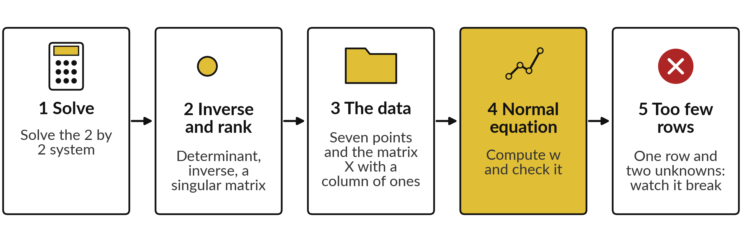
The lab has five steps, in the
notebook and in the workbook
Python uses np.linalg. The spreadsheet uses MMULT, MINVERSE, MDETERM and TRANSPOSE as array formulas. Gold cells are yours.
Notes:
Here is the map of the lab. Step one, solve the two by two system. Step two, find the determinant and the inverse, and meet a singular matrix. Step three, load the seven data points and build X. Step four, the main event: solve the normal equation and get the intercept and the slope.
Step five, break it on purpose with too few rows. In Python you use numpy. In the spreadsheet, you use array formulas such as MMULT and MINVERSE. Predict before you run each step.

Slide 27






Check your numbers against
these before you move on
What you compute | You should see
Solution x₁ and x₂ of the 2 by 2 system | 2 and 1
Determinant of A | −3
Top-left entry of the inverse of A | 0.33 (that is 1/3)
Rank of the singular matrix (rows (1, 2) and (2, 4)) | 1
XᵀX for the seven points | rows (7, 29) and (29, 155)
Intercept w₀ and slope w₁ | 9.06 and 5.43
RMSE of the line (least squares slide) | 1.09 (UGX million)
Determinant of XᵀX with one row | 0
If a number differs, stop and find the step that went wrong. Do not type a number to make a check green.
Notes:
Use this table as your checkpoint. If your numbers match, carry on. If they do not, stop and call me over, because every later step uses the earlier ones. The usual causes are a missing column of ones, X transpose typed as X, or a range that is one row too short in the spreadsheet.
The root mean squared error comes from the least squares slide: the square root of the total squared error divided by seven. Please do not edit a number just to make a check pass. Finding out why it differs is the skill you take away.

Slide 28



Four errors you will meet,
what they say and what to do
Error or symptom | What it says | What to do
LinAlgError: Singular matrix | The matrix has determinant 0, so no inverse. | Check the rank. Use lstsq instead.
ValueError: shapes not aligned | The inner sizes of a product do not match. | Print .shape of both and compare.
#VALUE! in an array formula | The result range has the wrong size, or Enter was used. | Select the exact range and confirm as an array formula.
Intercept comes out 0 | The column of ones is missing from X. | Add the column of ones.
Notes:
Errors are normal. Here are four you are likely to see. Singular matrix means the determinant is zero, so check the rank and use lstsq. Shapes not aligned means a product has mismatched inner sizes, so print the shape of both sides. In the spreadsheet, a value error in an array formula usually means the result range is the wrong size, so select the exact range first.
And an intercept of zero means the column of ones is missing. Read the last line of any error first. It usually tells you the answer.

Slide 29
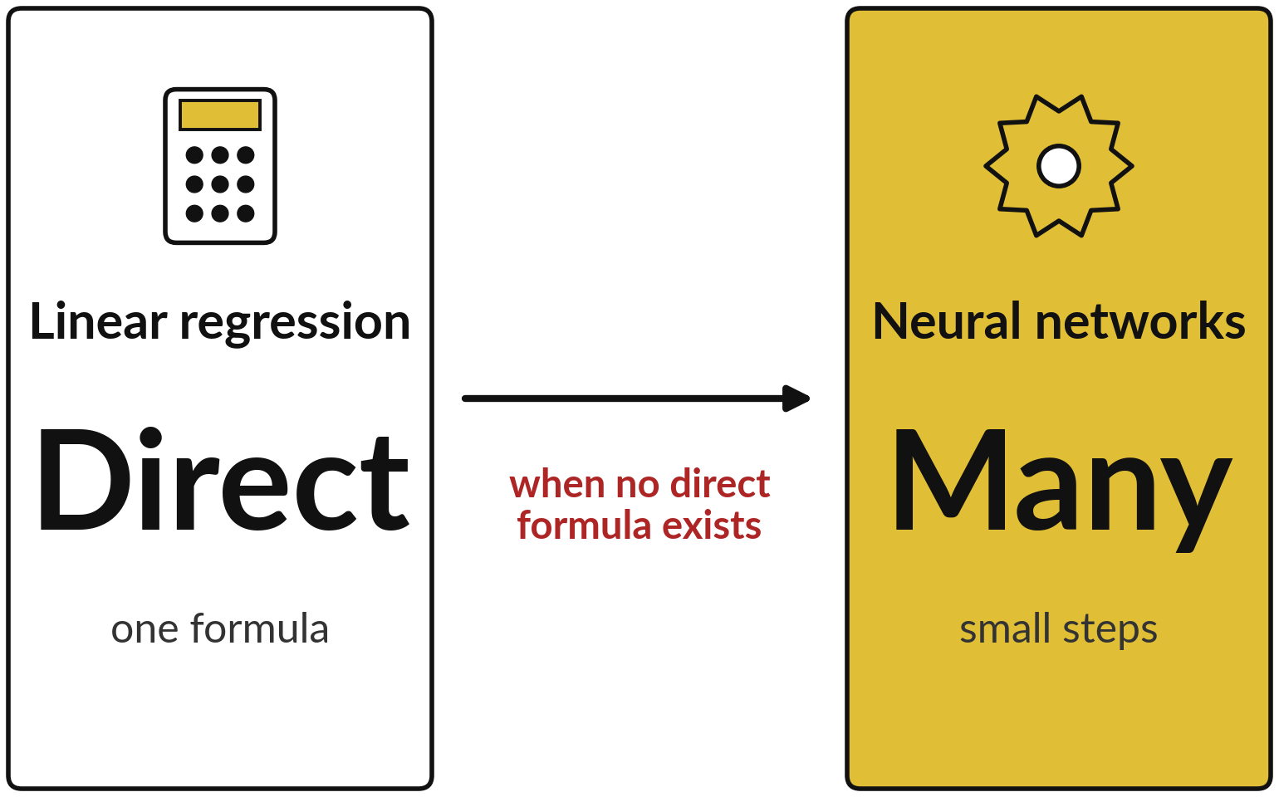
Where this appears in AI: solving in
one step, or improving in small steps
Linear regression has a closed-form answer. Models of this kind learn in many small updates.
Published work trains them with Adam, in small steps.
Most arithmetic in a layer is matrix multiplication (Vaswani et al., 2017).
Too many unknowns: add a penalty (ridge regression).
Notes:
So where does today appear in ChatGPT, Gemini, Claude and other AI?
Fitting a line has a direct solution, the normal equation you just used, and it is still a workhorse for small models. The big language models are different. Published research describes training them with gradient-based optimisation, usually the Adam family, which makes many small updates, because no single formula gives the answer.
Most of the arithmetic inside each layer is matrix multiplication, as the transformer paper by Vaswani and colleagues in 2017 describes. And when there are more unknowns than rows, as in our one-point example, many fits are exact. Published remedies add a penalty, called ridge regression, or use gradient descent from a chosen starting point. We study gradient methods from Session 10.

Slide 30
Where this appears in AI: check
an assistant with your numbers
8 minutes
Hands-on, with any AI assistant
Ask an assistant to fit the line, then check it against yours.
You keep
A note of where the assistant agrees with your numbers, and where it differs.
Type the seven spend and sales values from the worked example slide. Never paste confidential data.
Ask for a least squares line with the normal equation steps.
Compare its intercept and slope with 9.06 and 5.43.
Compare its determinant of XᵀX with 244.
Notes:
Now a short activity. Open any AI assistant that you use. Type in our seven made-up values and ask for the least squares line with the normal equation steps. Then compare its intercept and slope with ours, 9.06 and 5.43, and its determinant with two hundred forty-four. Assistants can make arithmetic slips, and checking is the skill.
Please never paste confidential company data into an assistant. Use only the invented numbers on the slide. What did you find when you compared?

Slide 31
Exit check: three questions with short answers
Question | Short answer
What does a determinant of 0 tell you about Ax = b? | A has no inverse. There is no solution or infinitely many, depending on b.
Why do we need a column of ones in X? | It gives the line an intercept w0. Without it the line passes through the origin.
Why does one data point and two unknowns break the normal equation? | XᵀX has determinant 0 and rank 1, so many lines fit equally well.
Write your own answer first, then compare. Your lab checks are part of the exit check.
Notes:
Three questions to finish. What does a determinant of zero tell you?
A has no inverse, so the system has no solution or infinitely many, depending on b. Why a column of ones in X?
It gives the line an intercept. Without it the line is forced through the origin. And why does one data point with two unknowns break the normal equation?
Because X transpose X then has determinant zero and rank one, so many lines fit equally well. Answer in your own words before you look at these.

Slide 32
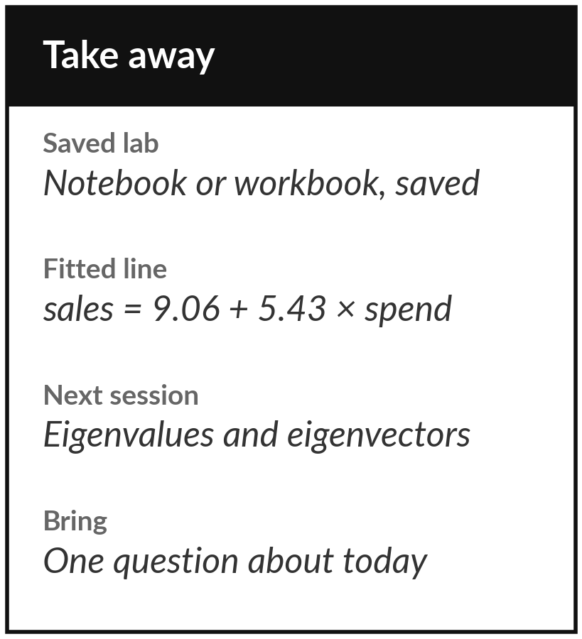
Save the lab and keep the fitted line
What you keep from today
Keep your saved notebook or workbook, and the two fitted numbers: intercept 9.06 and slope 5.43 for the advertising data.
Our question today
How does a computer find the best straight line through data in one step, and why does a model with more features than rows break?
Next session
Session 5: eigenvalues and eigenvectors, the directions a matrix only stretches.
Notes:
Before you go, save your notebook or workbook with all the checks green. Keep the fitted line: intercept nine point zero six and slope five point four three. Next session we ask which directions a matrix only stretches, and that leads to the idea behind principal component analysis.
If anything was unclear today, write your question down and bring it.
We began with this question: How does a computer find the best straight line through data in one step, and why does a model with more features than rows break? Before you go, say in one sentence what you can now say about it.

